Slide 1

DATA 602
FINAL PROJECT PRESENTATION
MOVING VIOLATIONS ISSUED IN D.C
By
Jaswanth Sai Nathani

Slide 2
Introduction
Data used in this project pertains to moving citations issued by law enforcement of various DC agencies and federal partners to violators.
If a vehicle is in motion when the transgression occurs, it is deemed a moving violation. This includes speeding, running a stop sign or red light, reckless driving, drunk driving (DUI/DWI), racing, and eluding an officer.
This data contains 70,458 records which includes 35 columns.
This data is available for open usage in open DC data portal and is free to access for everyone.

Slide 3
OBJECTIVE
Traffic violations are one of the major concerns in any part of the world. Understanding this data will help the government in taking necessary actions to prevent road accidents in the future. My objective is to understand and predict the reasons behind the most repeated violations which are causing road accidents and help reduce them

Slide 4
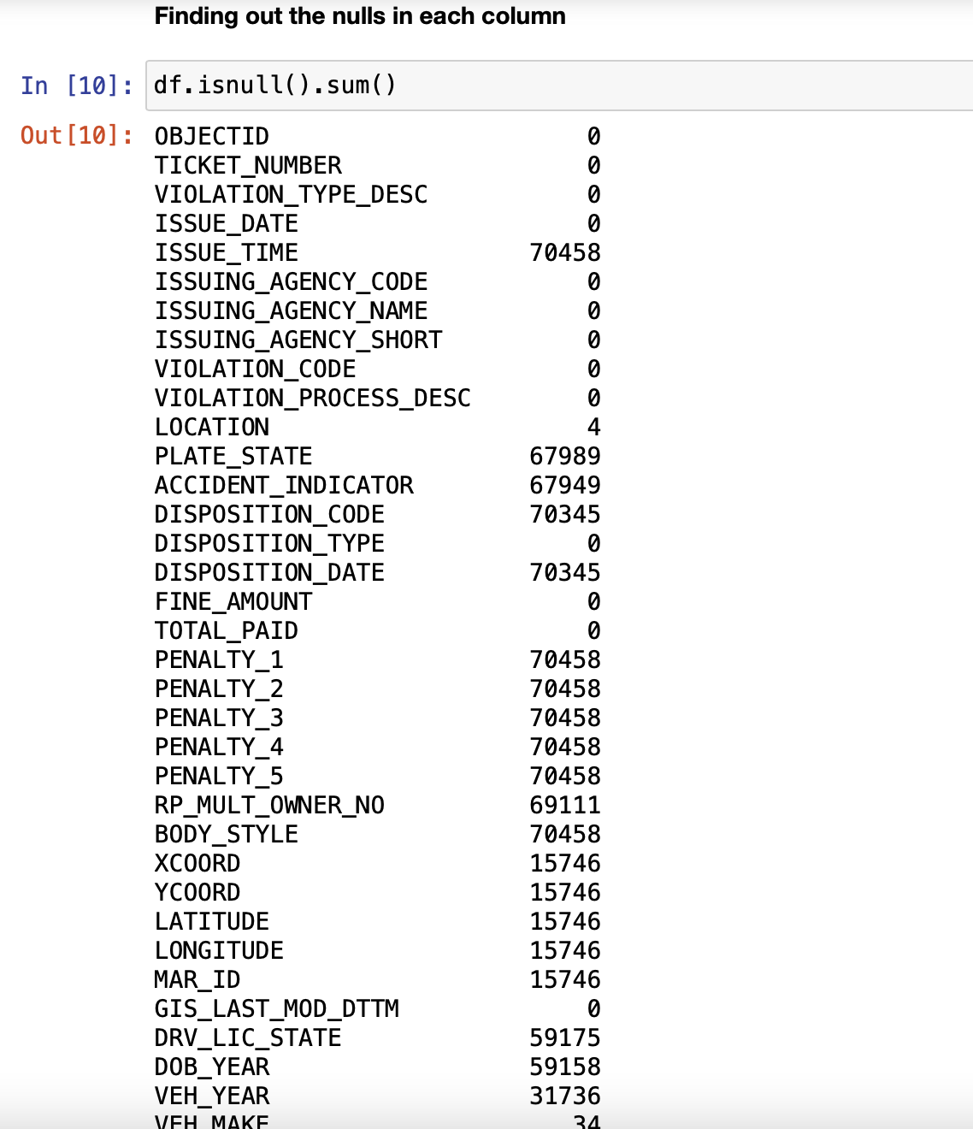
DATA CLEANING

Slide 5
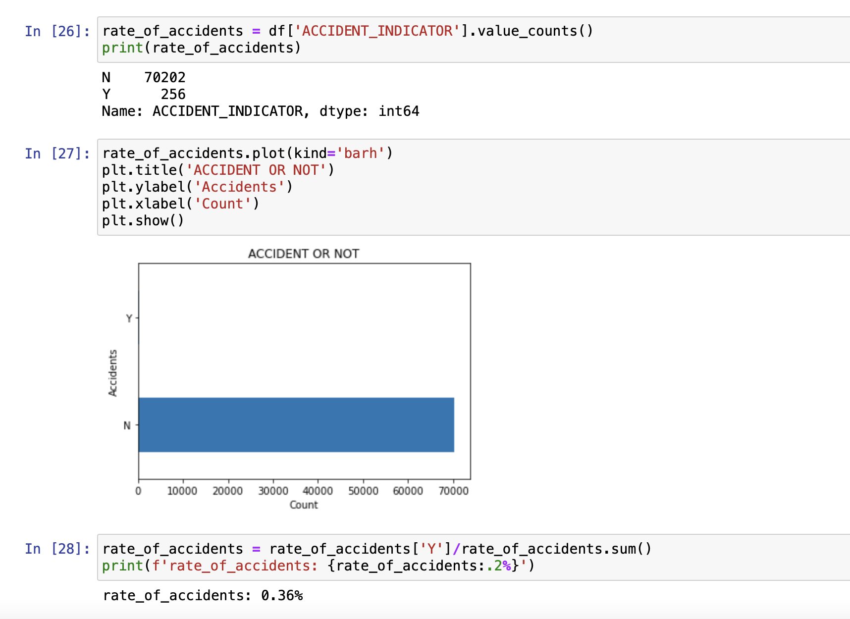
DATA VISUALIZATION

Slide 6
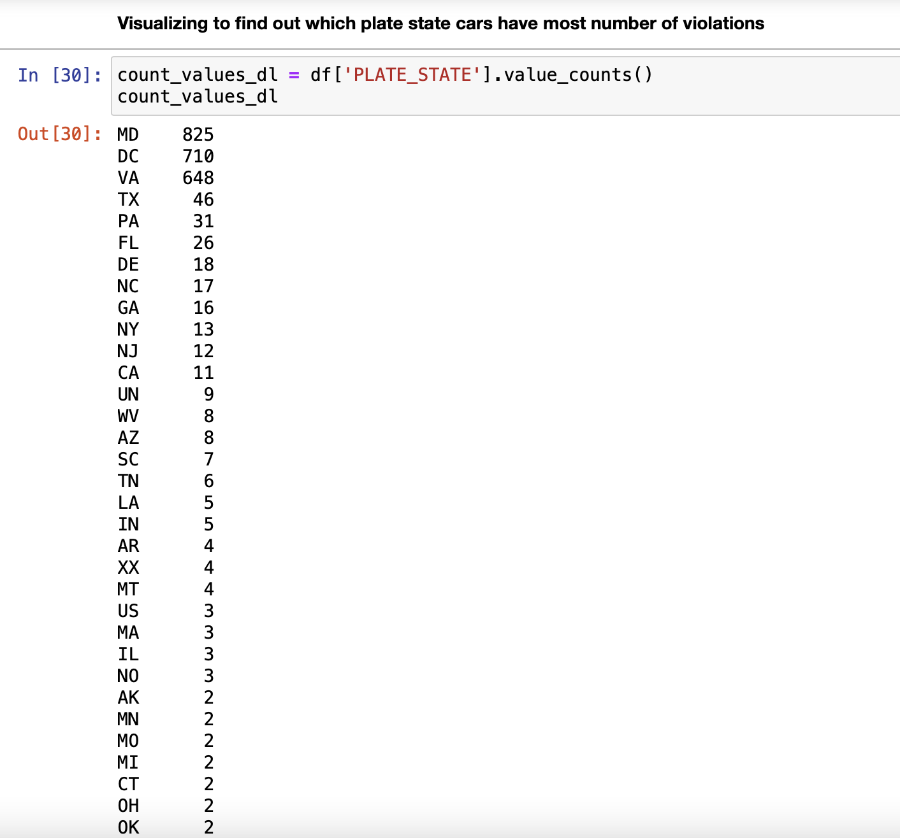
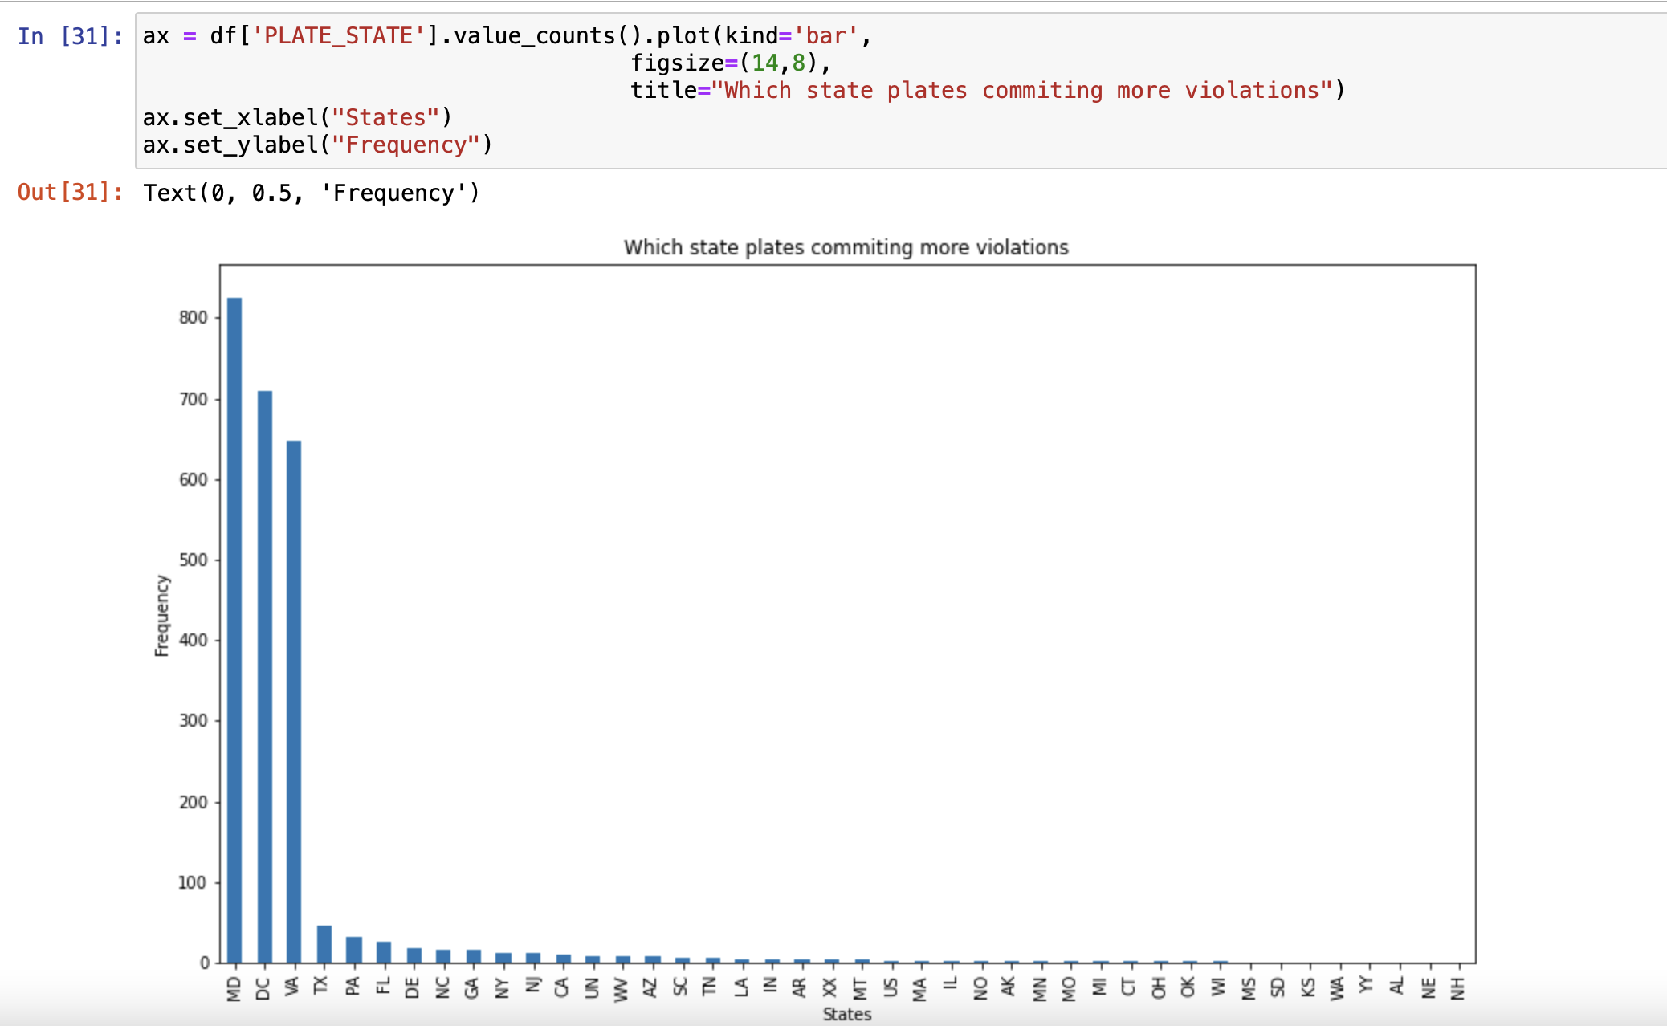
Visualization to understand which state registered vehicles committed more number of violations

Slide 7
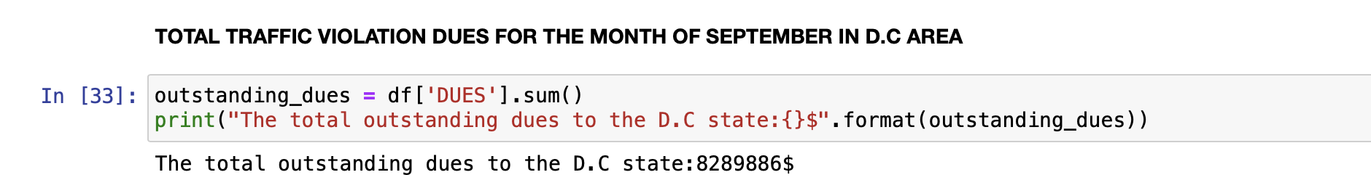

Slide 8
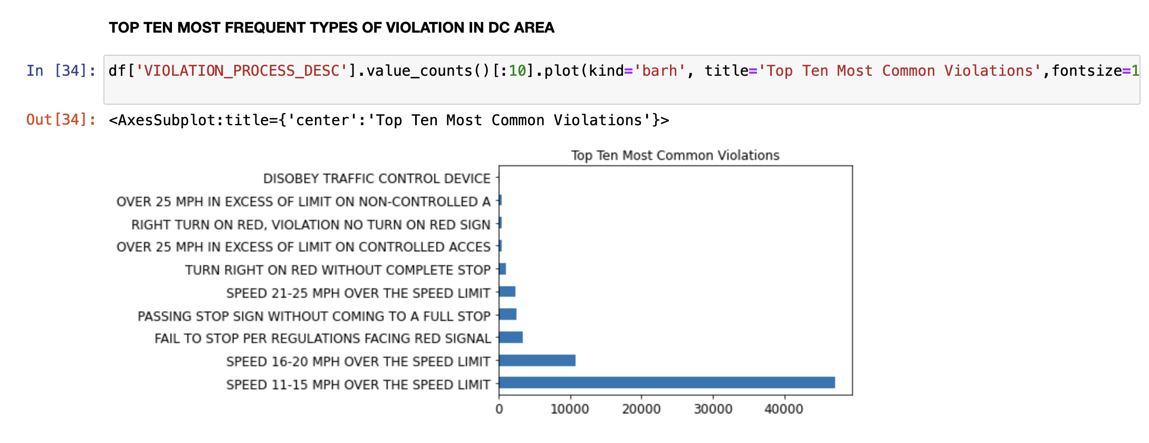

Slide 9
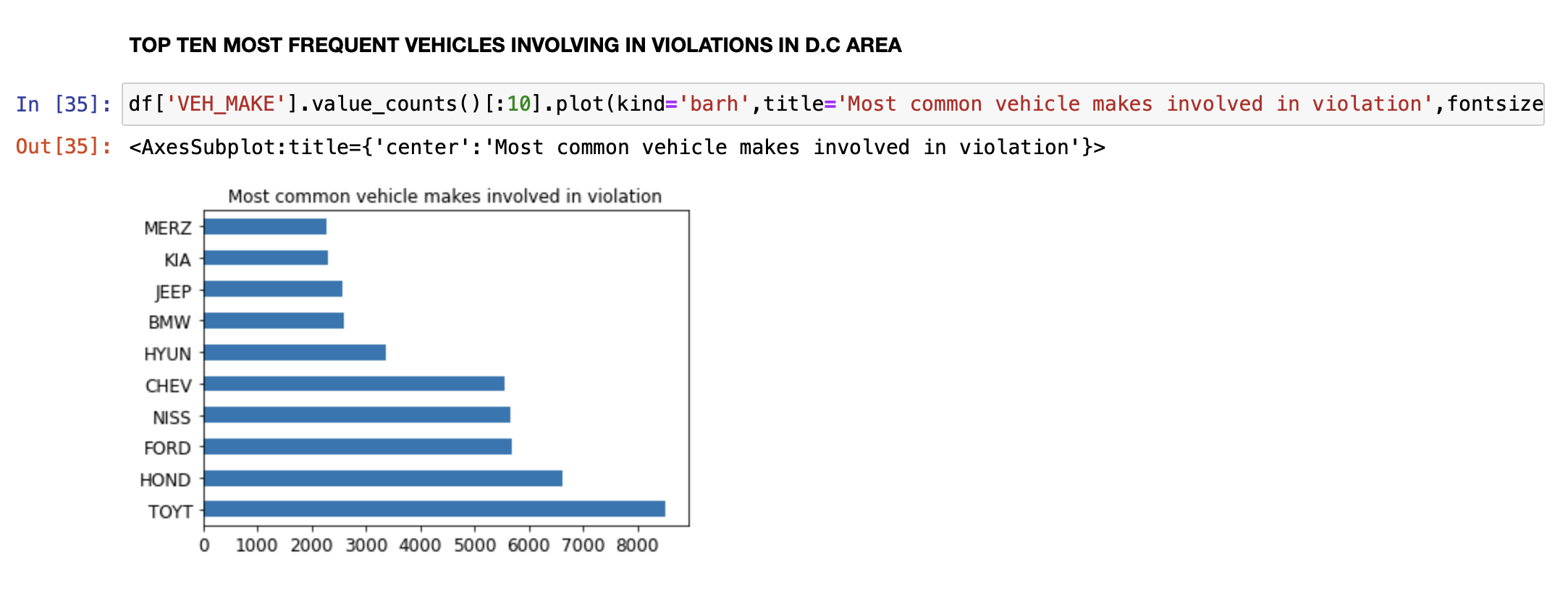

Slide 10
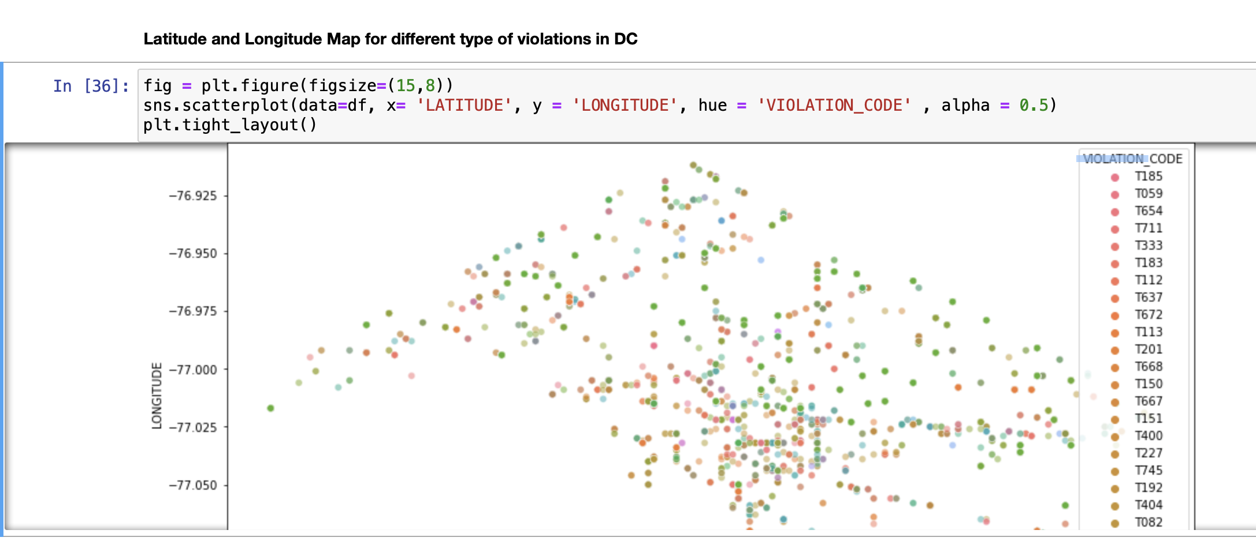

Slide 11
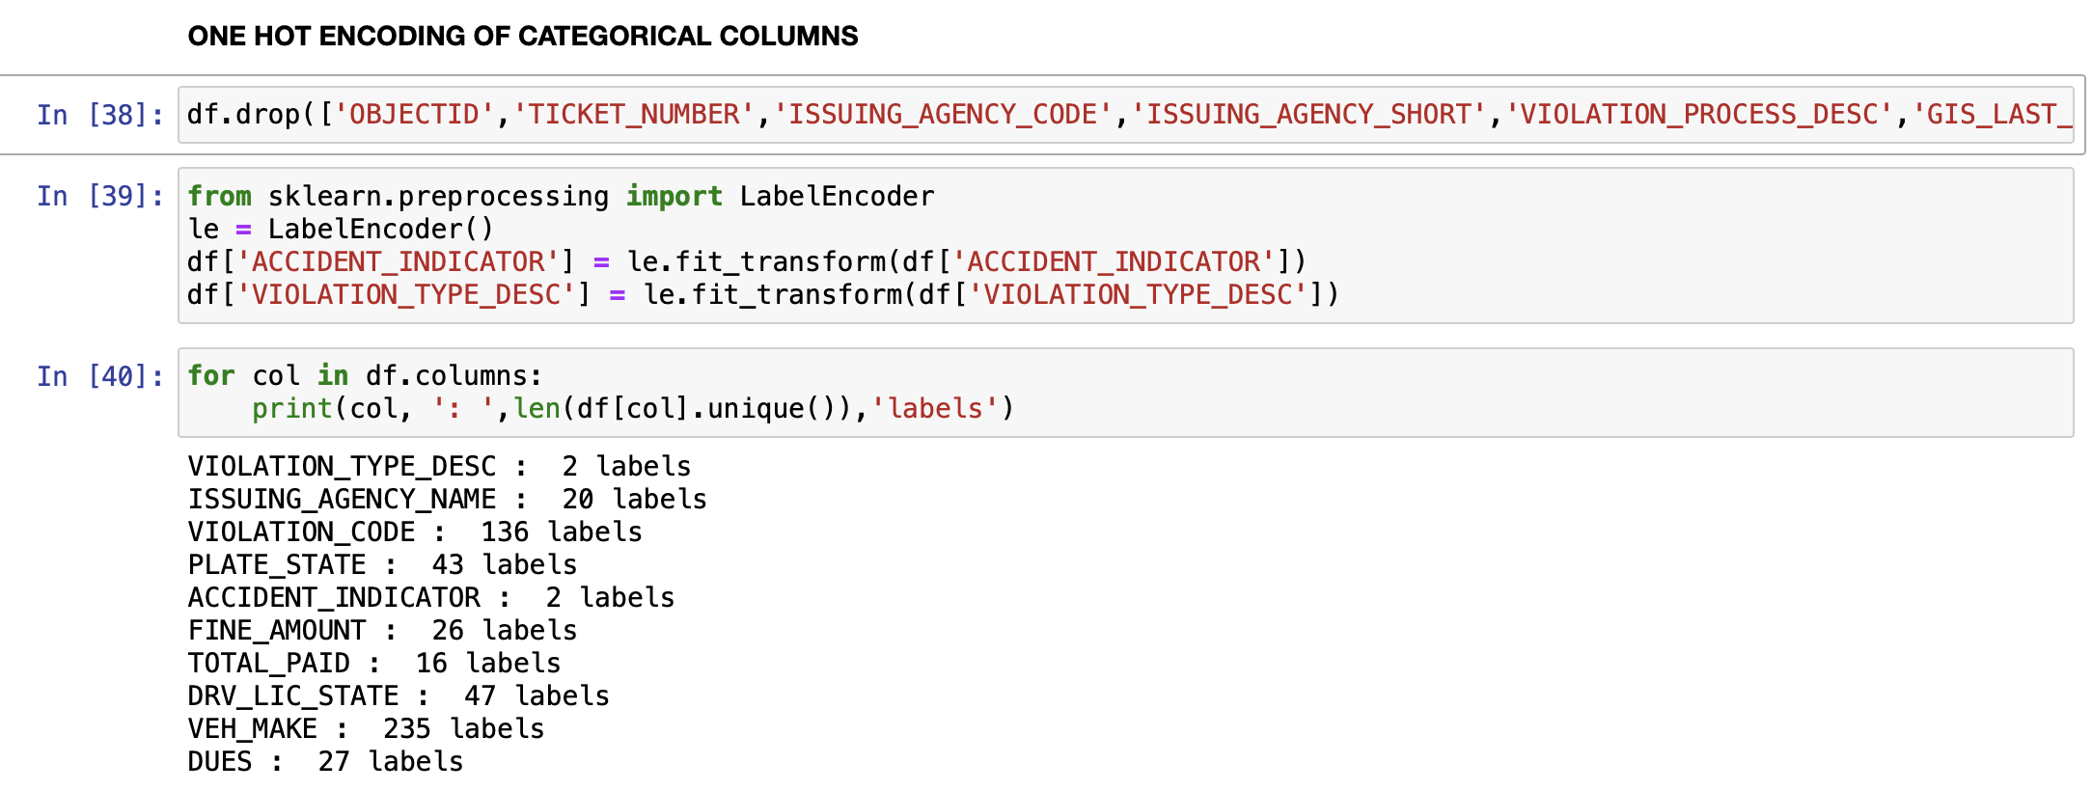
One Hot Encoding of Columns which we will be using for classification

Slide 12
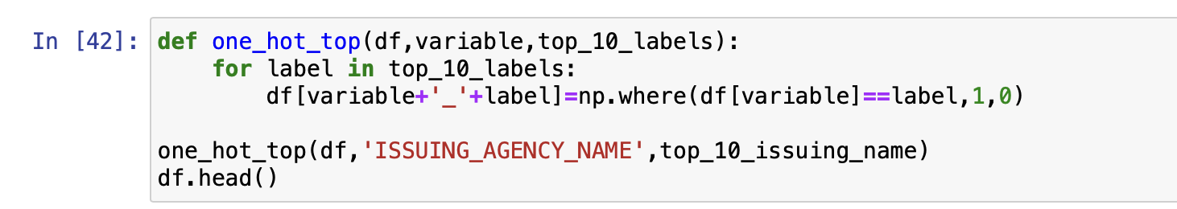
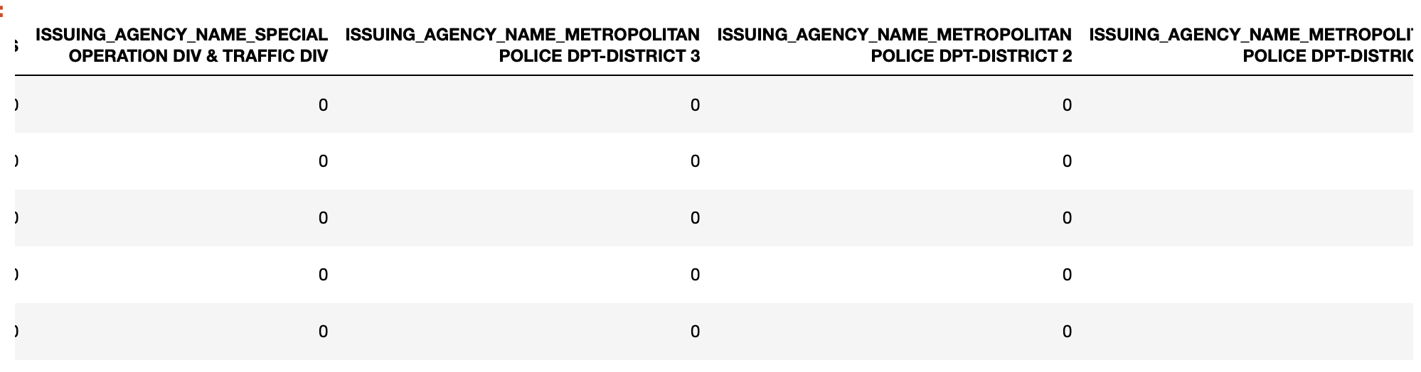

Slide 13
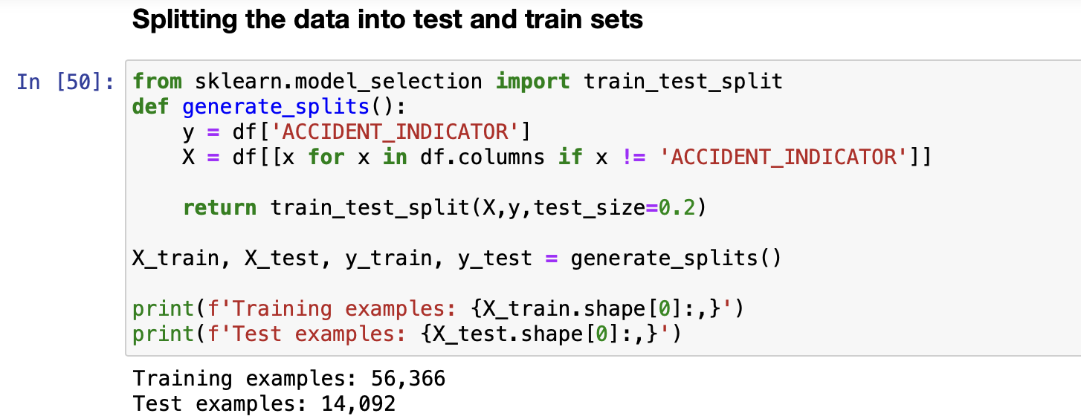

Slide 14
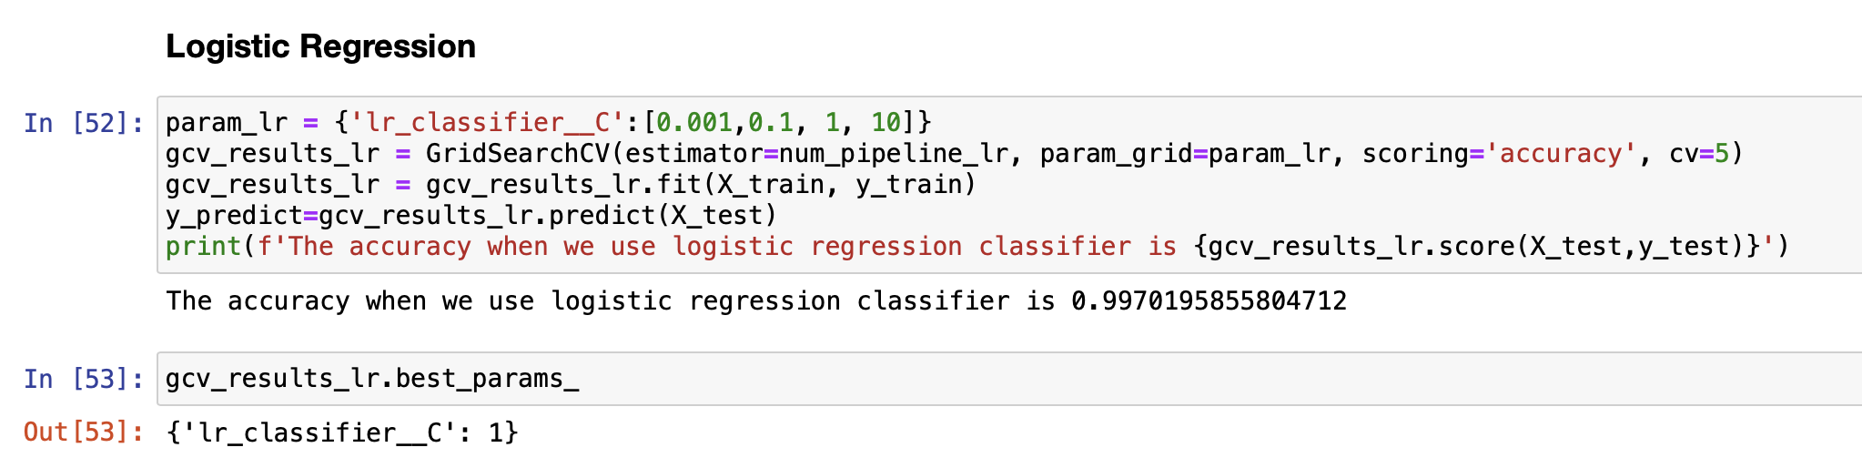
LOGISTIC REGRESSION MODEL

Slide 15
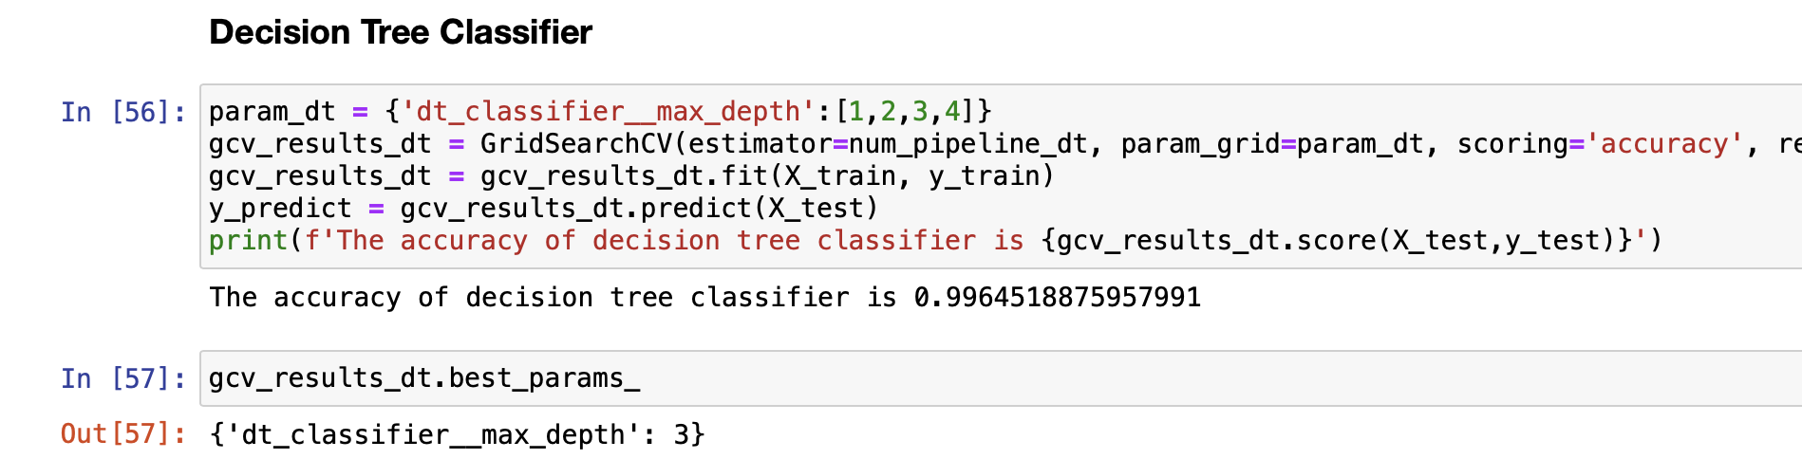
DECISION TREE CLASSIFIER

Slide 16
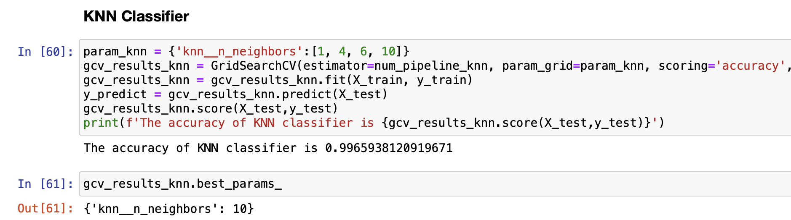
KNN CLASSIFIER

Slide 17
CONCLUSION
This dataset we have choosen have lot of data that is nulls which impacted our predictions
Also, the uneven distribution of target variable did not help in our cause.
Better data would have helped us in creating more estimations like age group of people who are most frequently committing violations.
It would also help us in identifying repeated violators and would help control them.

Slide 18
Thank You!

